Slide 1
Review and AI Agent Design III: Evaluation

Slide 2
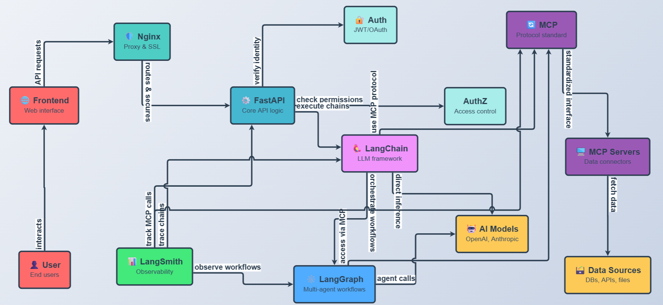
Chatbot UI
1. Most LLM API endpoint for

Slide 3
Chatbot UI
1. Most LLM API endpoint for

Slide 4
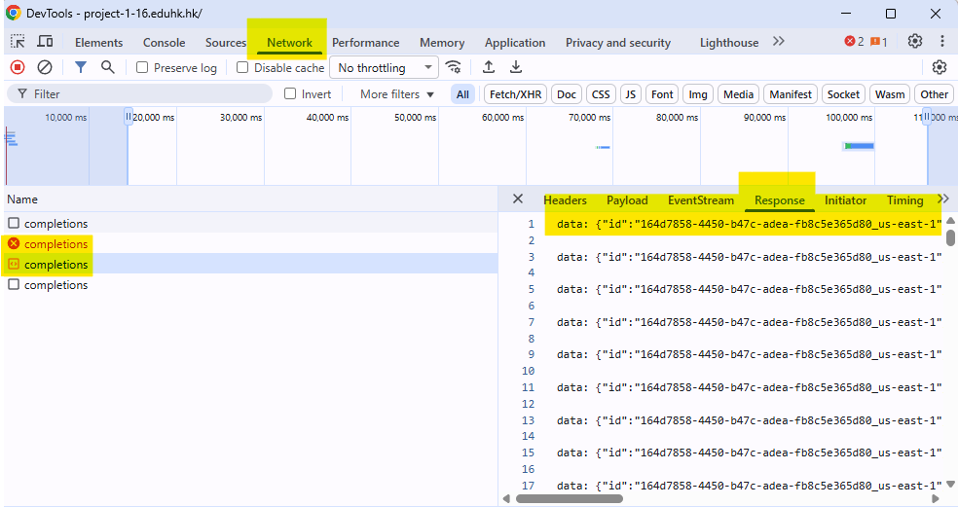
Chatbot UI
API endpoint is stateless
You need to sent full chat history to API endpoint
You can find the responses in the network tab

Slide 5
Why do you need to get the responses?
Name | Description | URL
Base44 | AI platform for building full-stack apps from prompts with auto-deployment. Free starter plan. | https://base44.ai/
Bolt.new | Browser-based AI for generating and deploying full-stack apps. Free tier for personal projects. | https://bolt.new/
Cline | Local-first AI coding agent for VS Code with task planning. Free open-source plan. | https://cline.app/
Windsurf | AI-native IDE with agentic editing and multi-model support. Free tier for individuals. | https://windsurf.com/
Cursor | AI-first code editor for generation and refactoring. Free tier with limited AI usage. | https://cursor.sh/
GitHub Copilot | AI for real-time code suggestions and PR reviews in IDEs. Free for individuals and OSS. | https://github.com/features/copilot
Replit | An AI-powered platform for building professional web apps and websites. | https://replit.com/

Slide 6
Chatbot UI vibe coding keywords
Single page html (for fast prototyping)
React (with Vite: Vite is a modern frontend build tool)
Vibe coding

Slide 7
Why Vite?
Fast Development Experience
Strong Ecosystem and Community Backing
Simplicity and Extensibility
ES Modules Facilitate UI Modularization

Slide 8
ES Modules Facilitate UI Modularization
Break down UI rendering designs into separate files
Frameworks like React, Vue, or vanilla JS
Performance Benefits: Modules enable code-splitting
(lazy-loading parts of the UI) and removing unused code,
which is crucial for fast-loading UIs.

Slide 10
Nginx
Serve static Front-End application
Reverse proxy to different web resource

Slide 11
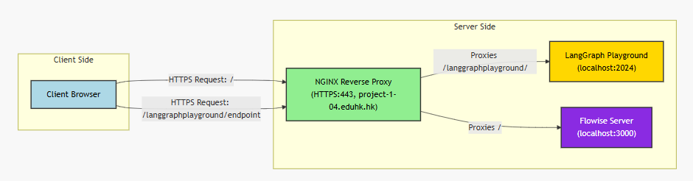
Nginx

Slide 12
Reverse proxy to different web resource
Forces everyone to use secure connections (HTTPS)
Routes different types of requests to different applications running on the server
Ensures secure, encrypted communication

Slide 13
Nginx
server {
listen 80;
server_name project-1-04.eduhk.hk;
return 301 https://$host$request_uri;
}
listen 80: Port 80 is the standard "door" for regular HTTP traffic (non-secure). This tells Nginx to watch this door.
server_name project-1-04.eduhk.hk: This says "I handle requests for project-1-04.eduhk.hk"

Slide 14
Nginx(return)
server {
listen 80;
server_name project-1-04.eduhk.hk;
return 301 https://$host$request_uri;
}
return 301 https://$host$request_uri:
What it does: This is a Nginx directive that immediately stops processing and sends a response back to the browser.
How it works:
When Nginx encounters return, it doesn't look at any other configuration below it
It immediately constructs and sends the response
No further processing happens for this request
Think of it like: A receptionist who says "Sorry, you need to go to a different building" and gives you the new address, instead of processing your request at the current location.

Slide 15
Nginx(301)
server {
listen 80;
server_name project-1-04.eduhk.hk;
return 301 https://$host$request_uri;
}
return 301 https://$host$request_uri:
What it is: An HTTP status code meaning "Moved Permanently“
HTTP Status Codes - Quick Overview:
2xx = Success (200 = OK)
3xx = Redirection (301 = Moved Permanently, 302 = Moved Temporarily)
4xx = Client Error (404 = Not Found)
5xx = Server Error (500 = Internal Server Error)

Slide 16
Nginx(301)
server {
listen 80;
server_name example.com www.example.com;
return 301 https://$host$request_uri;
}
return 301 https://$host$request_uri:
For HTTPS redirects, 301 is used because:
You always want HTTPS, forever
You want browsers to remember this
You want search engines to index the HTTPS version

Slide 17
Nginx(https://)
server {
listen 80;
server_name project-1-04.eduhk.hk;
return 301 https://$host$request_uri;
}
return 301 https://$host$request_uri:
What it is: The protocol/scheme for the new URL
This specifies:
Use the HTTPS protocol (secure, encrypted)
Browser should connect on port 443 (HTTPS default port)
An encrypted TLS/SSL connection must be established
The redirect changes only the protocol, not the domain or path.

Slide 18
Nginx($host)
server {
listen 80;
server_name project-1-04.eduhk.hk;
return 301 https://$host$request_uri;
}
What it is: A Nginx variable containing the hostname from the request
How it works: When a browser makes a request, it includes a "Host" header. Nginx captures this in the $host variable.
Does anyone know what a header is?

Slide 19
Nginx($host)
server {
listen 80;
server_name project-1-04.eduhk.hk;
return 301 https://$host$request_uri;
}
Benefit: Preserves whatever domain the user typed
www.project-1-04.eduhk.hk → https://www.project-1-04.eduhk.hk
project-1-04.eduhk.hk → https://project-1-04.eduhk.hk

Slide 20
Nginx($request_url)
server {
listen 80;
server_name project-1-04.eduhk.hk;
return 301 https://$host$request_uri;
}
What it is: A Nginx variable containing the complete original request path and query string
What it includes:
The path (everything after the domain)
Query parameters (the ? and everything after it)
Fragment identifiers are NOT included (the # part - browsers don't send this to servers)

Slide 21
Nginx(location /langgraphplayground/)
location /langgraphplayground/
What it matches: Any URL starting with /langgraphplayground/
Examples:
✓ https://project-1-04.eduhk.hk/langgraphplayground/
✓ https://project-1-04.eduhk.hk/langgraphplayground/api/chat
✓ https://project-1-04.eduhk.hk/langgraphplayground/static/logo.png
✗ https://project-1-04.eduhk.hk/langGraph/ (case-sensitive)
✗ https://project-1-04.eduhk.hk/other/path

Slide 22
Nginx(location /langgraphplayground/)
The trailing slash matters:
location /langgraphplayground/ { # With trailing slash
# Matches: /langgraphplayground/*, but NOT /langgraphplayground
}
location /langgraphplayground { # Without trailing slash
# Matches: /langgraphplayground and /langgraphplayground/*
}
In your case, with the trailing slash:
/langgraphplayground → Goes to location / (caught by second block)
/langgraphplayground/ → Goes to this block ✓
/langgraphplayground/chat → Goes to this block ✓

Slide 23
Nginx(SSE Requirements)
location /langgraphplayground/ {
proxy_pass http://localhost:2024;
proxy_http_version 1.1; # ✓ HTTP/1.1 (good for SSE)
proxy_buffering off; # ✓ if you want streams immediately
proxy_cache off; # ✓ No caching
proxy_read_timeout 300s; # ✓ Long timeout for persistent connection
# ... other headers
}
For SSE to work properly, you need:
- HTTP/1.1 (technically works with 1.0, but 1.1 is better)
- No response buffering (if you want streams immediately)
- Long read timeout (SSE connections stay open)
- No caching (each event stream is unique)

Slide 24
Nginx (if you want streaming)
location / {
proxy_pass http://localhost:3000;
# CRITICAL for Flowise streaming
proxy_http_version 1.1; # ← ADD THIS
proxy_set_header Connection ""; # ← ADD THIS
proxy_buffering off; # ← ADD THIS
proxy_cache off; # ← ADD THIS
proxy_read_timeout 300s; # ← ADD THIS (AI can take time)
# Standard headers
proxy_set_header Host $host;
proxy_set_header X-Real-IP $remote_addr;
proxy_set_header X-Forwarded-For $proxy_add_x_forwarded_for;
proxy_set_header X-Forwarded-Proto $scheme;
}
sudo nginx –t
sudo systemctl reload nginx

Slide 26
FastAPI and LangChain and LangGraph
LangChain as the Foundation
Handles core LLM logic, such as chaining prompts, managing memory (e.g., conversation history), and integrating external tools/data sources. It's the "brain" for simple interactions.
LangGraph as the Orchestrator
Builds on LangChain to create dynamic, graph-based workflows. In chatbots, it manages multi-turn conversations, agentic behaviors (e.g., deciding when to call tools or end a loop), and state persistence across sessions.
FastAPI as the Interface
Serves as the entry point, turning the LangChain/LangGraph logic into a web service. It handles routing, request validation, and response streaming, making the chatbot accessible via APIs for frontends or integrations and serving the frontend.

Slide 27
The relationship between LangGraph and LangChain and FastAPI
from typing import Annotated, Sequence
from fastapi import FastAPI, Request
from fastapi.responses import HTMLResponse
from fastapi.staticfiles import StaticFiles
from pydantic import BaseModel
from langchain_core.messages import BaseMessage, SystemMessage, HumanMessage, ToolMessage
from langgraph.graph.message import add_messages
from langgraph.graph import StateGraph, END
from langchain_core.tools import tool
from langchain_aws import ChatBedrock
from langgraph.checkpoint.memory import MemorySaver
import json

Slide 28
What is Sequence? Like [“1”, “2”, “3”]
from typing import Sequence
# ❌ Too restrictive - only accepts lists
def process_items(items: list[str]) -> int:
return len(items)
# ✅ Better - accepts any sequence type
def process_items(items: Sequence[str]) -> int:
return len(items)
# Now all of these work:
process_items(["a", "b", "c"]) # list ✓
process_items(("a", "b", "c")) # tuple ✓
process_items({"a", "b", "c"}) # ✗ set is NOT a sequence (unordered)

Slide 29
What is Annotated? For documentation
from typing import Annotated
def send_email(
recipient: Annotated[str, "Email address of the recipient"],
subject: Annotated[str, "Email subject line, max 100 chars"],
body: Annotated[str, "HTML or plain text email body"]
) -> None:
...

Slide 30
What is FastAPI?
from fastapi import FastAPI
app = FastAPI(
title="My API", # API name (shows in docs)
description="A cool API", # API description
version="1.0.0", # API version
)

Slide 31
What is FastAPI?
from fastapi import FastAPI, Request
from fastapi.responses import HTMLResponse
from fastapi.staticfiles import StaticFiles
Request
1. Purpose: Represents HTTP request data
2. Use Case: Access request headers, body, query parameters, etc.
HTMLResponse
1. Purpose: Returns HTML content in HTTP responses
2. Use Case: Serve web pages directly from FastAPI
StaticFiles
1. Purpose: Serves static files (CSS, JavaScript, images)
2. Use Case: Mount static file directories to the application

Slide 32
What is Pydantic?
What is Pydantic?
Data validation and settings management using Python type annotations
BaseModel: Base class for creating data models with automatic validation
from pydantic import BaseModel
class ChatRequest(BaseModel):
message: str
thread_id: str

Slide 33
The relationship between LangGraph and LangChain and FastAPI: FastAPI code
# Serving Static files
app = FastAPI()
app.mount("/static", StaticFiles(directory="static", html=True), name="static")
# LangChain and LangGraph logic starts
#...
# LangChain and LangGraph logic ends
# Frontend calling these endpoints
@app.get("/", response_class=HTMLResponse)
async def root(request: Request):
return HTMLResponse(open("static/index.html").read())
@app.post("/chat")
async def chat(input: ChatInput):
config = {"configurable": {"thread_id": input.thread_id}}
state = {"messages": [HumanMessage(content=input.message)]}
result = graph.invoke(state, config)
return {"response": result["messages"][-1].content}

Slide 34
The relationship between LangGraph and LangChain and FastAPI: LangChain code
# LLM: AWS Nova Lite via Bedrock
llm = ChatBedrock(model_id="amazon.nova-lite-v1:0", region_name="us-east-1")
# Simple tool
@tool
def multiply(a: int, b: int) -> int:
"""Multiply two numbers."""
return a * b
tools = [multiply]
llm = llm.bind_tools(tools)
tools_by_name = {tool.name: tool for tool in tools}

Slide 35
The relationship between LangGraph and LangChain and FastAPI: LangGraph code
# State
class AgentState(dict):
messages: Annotated[Sequence[BaseMessage], add_messages]
# Nodes
def tool_node(state: AgentState):
outputs = []
for tool_call in state["messages"][-1].tool_calls:
tool_result = tools_by_name[tool_call["name"]].invoke(tool_call["args"])
outputs.append(ToolMessage(content=json.dumps(tool_result), name=tool_call["name"], tool_call_id=tool_call["id"]))
return {"messages": outputs}
def call_model(state: AgentState):
system_prompt = SystemMessage("You are a helpful AI. Use tools if needed.")
response = llm.invoke([system_prompt] + state["messages"])
return {"messages": [response]}

Slide 36
The relationship between LangGraph and LangChain and FastAPI: LangGraph code
# Condition
def should_continue(state: AgentState):
last_message = state["messages"][-1]
if not last_message.tool_calls:
return "end"
return "continue"
# Graph
workflow = StateGraph(state_schema=AgentState)
workflow.add_node("agent", call_model)
workflow.add_node("tools", tool_node)
workflow.set_entry_point("agent")
workflow.add_conditional_edges("agent", should_continue, {"continue": "tools", "end": END})
workflow.add_edge("tools", "agent")
memory = MemorySaver()
graph = workflow.compile(checkpointer=memory)
class ChatInput(BaseModel):
message: str
thread_id: str = "1" # Default for simplicity

Slide 37
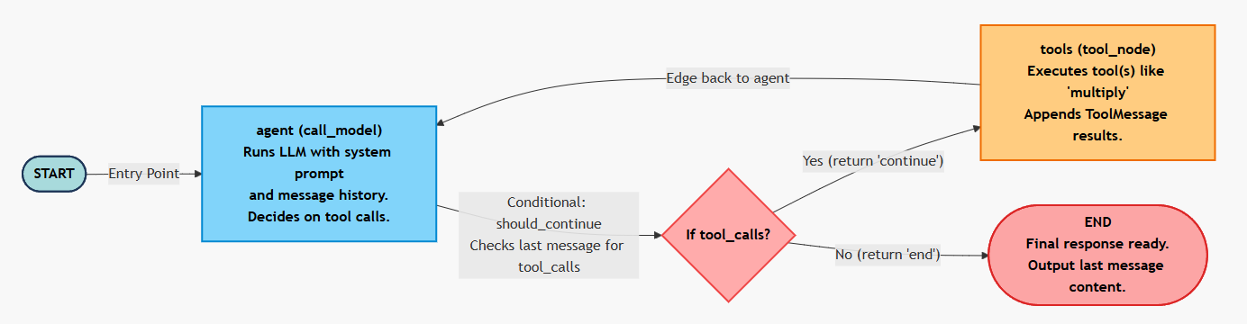
The relationship between LangGraph and LangChain and FastAPI: LangGraph code
LangGraph
LangChain
LangChain

Slide 38
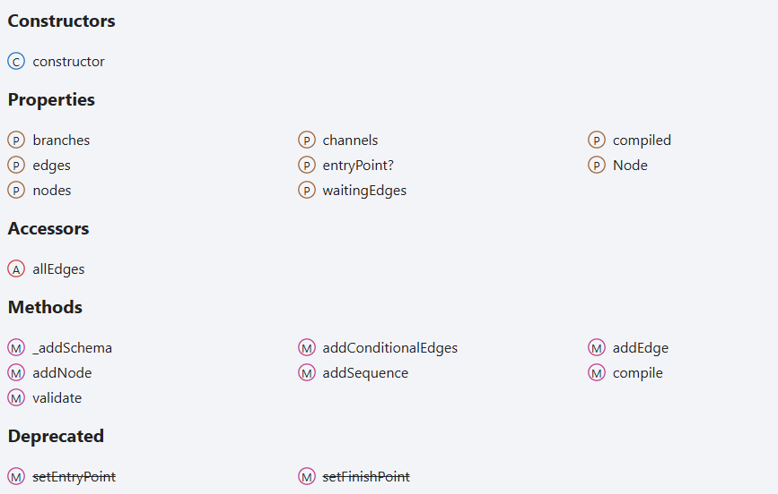
The relationship between LangGraph and LangChain and FastAPI: LangGraph doc demo
https://langchain-ai.github.io/langgraphjs/reference/classes/langgraph.StateGraph.html

Slide 39
Frontend
<!DOCTYPE html>
<html><body>
<div id="messages"></div>
<input id="input" placeholder="Type message"><button onclick="send()">Send</button>
<script>
const threadId = crypto.randomUUID(); // Unique per instance
async function send() {
const inp = document.getElementById('input');
const msg = inp.value; inp.value = '';
document.getElementById('messages').innerHTML += `<p>You: ${msg}</p>`;
const res = await fetch('/chat', {method: 'POST', headers: {'Content-Type': 'application/json'}, body: JSON.stringify({message: msg, thread_id: threadId})});
const data = await res.json();
document.getElementById('messages').innerHTML += `<p>Bot: ${data.response}</p>`;
}
</script>
</body></html>

Slide 40
config = {"configurable": {"thread_id": input.thread_id}}
The config dict passes the actual thread_id (from the request input) to LangGraph's checkpointer during graph.invoke().
This overrides the default and enables the MemorySaver to load/save state (including message history) specific to that thread_id, isolating conversations across different users or sessions.
const res = await fetch('/chat', {method: 'POST', headers: {'Content-Type': 'application/json'}, body: JSON.stringify({message: msg, thread_id: threadId})});

Slide 41
Why thread_id: str = "1" # Default for simplicity?
1) This is in the ChatInput Pydantic model for request validation.
2) It sets a default value of "1" for thread_id if the frontend doesn't provide one in the POST body.
This ensures the API doesn't fail on missing fields (e.g., for quick testing), while allowing overrides for unique sessions.
class ChatInput(BaseModel):
message: str
thread_id: str = "1" # Default for simplicity

Slide 42
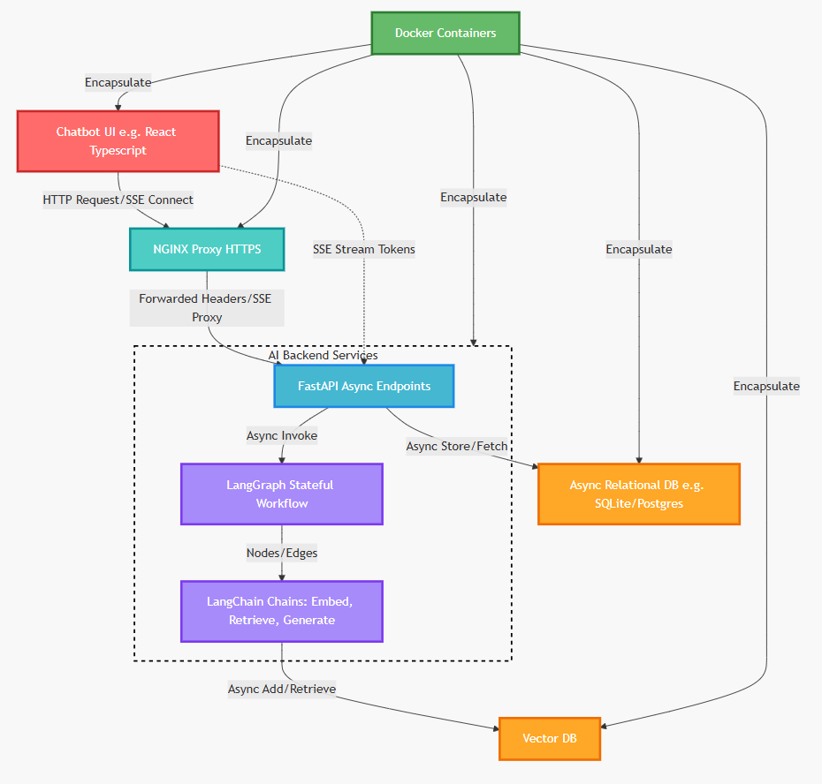
Why Docker?

Slide 43
Why Docker?
Consistency Across Environments:
Docker ensures that applications run the same way in development, testing, staging, and production.
Portability:
Containers can be easily moved and deployed across different machines, clouds, or operating systems without reconfiguration.
Isolation and Security:
Each container runs in its own isolated environment, preventing conflicts between applications (e.g., different versions of libraries).
Resource Efficiency:
Unlike virtual machines, Docker containers share the host OS kernel, making them lightweight and fast to start
Scalability and Speed:
Containers can be scaled up or down quickly, supporting microservices architectures.
Improved Development Productivity:
Developers can work in identical environments, simplifying collaboration and onboarding.

Slide 45
What is LangSmith?
LangSmith is an evaluation and monitoring platform for AI agents and LLM applications.
2) It helps developers systematically test, track, and improve their AI systems through structured evaluation frameworks.
3) The platform provides tools for creating datasets, running experiments, and analyzing agent performance.

Slide 46
What are Traces in LangSmith?
Traces are comprehensive logs of your agent's execution runs.
They capture inputs, outputs, latencies, and any errors that occur during runtime.
These traces provide visibility into how your agent behaves and help identify issues or optimization opportunities.
# Enable tracing in your .env file
LANGCHAIN_TRACING_V2=true
LANGCHAIN_API_KEY=lsv2_pt_...
LANGCHAIN_PROJECT=your-project-name
# Traces are automatically captured when you run your agent
from langchain_aws import ChatBedrock
llm = ChatBedrock(model_id="amazon.nova-lite-v1:0")
response = llm.invoke("Hello") # This run is traced

Slide 47
Why Do We Need Datasets?
Datasets are collections of test examples with inputs and optional expected outputs.
They enable repeatable testing across different versions of your agent.
By maintaining consistent test cases, you can objectively measure improvements or regressions over time.

Slide 48
How Do We Create Datasets?
from langsmith import Client
client = Client()
# Create a dataset
dataset = client.create_dataset(
dataset_name="MTR Simple QA",
description="Simple Q&A examples for MTR"
)
# Batch create examples
examples = [
{
"inputs": {"question": "What is MTR?"},
"outputs": {"answer": "Mass Transit Railway"}
},
{
"inputs": {"question": "How many lines?"},
"outputs": {"answer": "10 lines"}
},
]
client.create_examples(
inputs=[ex["inputs"] for ex in examples],
outputs=[ex["outputs"] for ex in examples],
dataset_id=dataset.id,
)
Create datasets using the LangSmith Client with create_dataset() and add examples with create_examples().
You can batch-create multiple examples at once with inputs and expected outputs.
Dataset versioning allows you to track changes and evaluate against specific versions.

Slide 49
What are Evaluators?
Evaluators are functions that score your agent's outputs against quality criteria.
They can use string matching, LLM-as-judge patterns, or custom logic for metrics like correctness or tool usage.
Multiple evaluators can be combined to assess different aspects of agent performance.

Slide 50
What Types of Evaluators Exist?
# 1. Built-in String Evaluator (LLM-as-judge)
correctness_evaluator = LangChainStringEvaluator(
"labeled_score_string",
config={
"criteria": {
"correctness": "Is the response factually correct?"
},
"normalize_by": 10 # Score out of 10
}
)
# 2. Custom Evaluator
@run_evaluator
def exact_match(run, example):
prediction = run.outputs["answer"]
reference = example.outputs["answer"]
return {"key": "exact_match", "score": prediction == reference}
Row-level evaluators score individual examples (exact match, keyword presence, conciseness).
Summary evaluators aggregate metrics across entire datasets.
Comparative evaluators judge which of two outputs is better, useful for A/B testing different agent versions.

Slide 51
What is Trajectory Evaluation?
Trajectory evaluation examines the sequence of actions an agent takes, not just the final output.
It validates that tools are called in the correct order and with appropriate parameters.
This is crucial for multi-step reasoning and complex agent workflows.
@run_evaluator
def tool_usage_evaluator(run, example):
# Check if tool was called when expected
tool_calls = [
msg for msg in run.outputs["messages"]
if isinstance(msg, ToolMessage)
]
expected_tool = "multiply" in example.inputs["question"].lower()
actual_tool = len(tool_calls) > 0
score = 1 if expected_tool == actual_tool else 0
return {
"key": "tool_usage_correct",
"score": score,
"comment": f"Expected tool: {expected_tool}, Used: {actual_tool}"
}

Slide 52
What are Experiments?
Experiments are tracked runs of your agent on specific datasets with associated evaluators.
Each experiment captures metrics, metadata (model version, prompts), and timestamps.
Experiments enable systematic comparison of different agent configurations or improvements.

Slide 53
How Do We Run Evaluations?
from langsmith.evaluation import evaluate
def my_agent(inputs: dict) -> dict:
"""Your system to evaluate."""
response = llm.invoke(inputs["question"])
return {"answer": response.content}
# Run evaluation
results = evaluate(
my_agent, # Your target function
data="MTR Simple QA", # Dataset name
evaluators=[exact_match, correctness_evaluator],
experiment_prefix="baseline-v1",
description="First baseline evaluation",
metadata={
"model": "amazon.nova-lite-v1:0",
"temperature": 0.0,
},
max_concurrency=4,
)
print(f"Average score: {results['results'][0]['score']}")
Use the evaluate() function with your target function, dataset, and evaluators.
For better performance, use aevaluate() for async evaluation with higher concurrency.
Results include scores, metadata, and detailed traces for each test example.

Slide 54
How Can We Compare Different Versions?
from langsmith.evaluation import evaluate_comparative
# Run two experiments
exp1 = evaluate(agent_v1, data="MTR Simple QA", evaluators=[...])
exp2 = evaluate(agent_v2, data="MTR Simple QA", evaluators=[...])
# Compare with pairwise evaluator
def preference_evaluator(inputs: dict, runs: list) -> dict:
"""LLM judges which output is better."""
prompt = f"""Question: {inputs['question']}
Answer A: {runs[0].outputs['answer']}
Answer B: {runs[1].outputs['answer']}
Which answer is better? Return score for A and B."""
# Use LLM to judge (simplified)
return {"key": "preference", "scores": [0.3, 0.7]}
results = evaluate_comparative(
experiments=(exp1.experiment_name, exp2.experiment_name),
evaluators=[preference_evaluator],
randomize_order=True, # Reduce bias
)
Use evaluate_comparative() to compare two experiments with pairwise evaluators.
The platform can randomize comparison order to reduce bias.
Results show which version performs better across your test dataset with statistical metrics.

Slide 55
What is Async Evaluation?
Async evaluation uses aevaluate() for better performance with concurrent requests.
It allows higher concurrency levels than synchronous evaluation.
This significantly reduces total evaluation time for large datasets.
from langsmith import aevaluate
async def async_agent(inputs: dict) -> dict:
"""Async version of your agent."""
response = await async_llm.ainvoke(inputs["question"])
return {"answer": response.content}
# Run async evaluation with higher concurrency
results = await aevaluate(
async_agent,
data="MTR Simple QA",
evaluators=[exact_match, correctness_evaluator],
max_concurrency=10, # Process 10 examples simultaneously
experiment_prefix="async-baseline",
)

Slide 56
What Metadata Should We Track?
# Add metadata to experiments
results = evaluate(
my_agent,
data="MTR Simple QA",
evaluators=[evaluators],
metadata={
"model": "amazon.nova-lite-v1:0",
"temperature": 0.7,
"prompt_version": "v2.1",
"date": "2025-10-24",
"engineer": "team-ai"
}
)
# Version your datasets too
client.update_dataset(
dataset_id=dataset.id,
metadata={
"version": "v1.0",
"created_date": "2025-10-24"
}
)
Track model versions, temperature settings, prompt templates, and timestamps in experiment metadata.
This enables filtering and grouping results in the LangSmith UI.
Metadata makes results reproducible and helps identify which changes improved performance.

Slide 57
What are Best Practices?
Always tag experiments with metadata and establish baselines before making changes.
Use async evaluation for better performance and run multiple repetitions for statistical significance.
Include edge cases in datasets and use multiple evaluator types beyond just exact matching.
# Best practice: Run with repetitions
results = evaluate(
my_agent,
data="MTR Simple QA",
evaluators=[exact_match, correctness, conciseness],
num_repetitions=3, # Run each example 3 times
metadata={
"model": "amazon.nova-lite-v1:0",
"version": "baseline"
}
)
# Best practice: Include diverse evaluators
evaluators = [
exact_match, # Exact string match
keyword_match, # Contains key terms
correctness_llm, # LLM judges correctness
conciseness, # Response length
tool_usage_correct, # Trajectory validation
]

Slide 58
What Can We Do in the LangSmith UI?
The web interface at smith.langchain.com provides visual experiment comparison and detailed trace inspection.
You can analyze aggregate metrics, filter by metadata, and add human feedback.
The UI makes it easy to share results and collaborate on improvements.

Slide 59
How Does This Improve AI Agents?
# Complete evaluation workflow
from langsmith import Client
from langsmith.evaluation import evaluate
# 1. Create dataset
client = Client()
dataset = client.create_dataset("Production Tests")
# 2. Define evaluators
evaluators = [correctness, conciseness, tool_usage]
# 3. Run baseline
baseline = evaluate(agent_v1, data=dataset, evaluators=evaluators)
# 4. Make improvements to your agent
# ... modify prompts, add tools, tune parameters ...
# 5. Run new experiment
improved = evaluate(agent_v2, data=dataset, evaluators=evaluators)
# 6. Compare results in UI or programmatically
print(f"Baseline: {baseline.metrics}")
print(f"Improved: {improved.metrics}")
Systematic evaluation reveals strengths and weaknesses in agent behavior objectively.
Experiment tracking shows whether changes actually improve performance.
The iterative cycle of test-measure-improve leads to more reliable and capable AI systems over time.

Slide 60
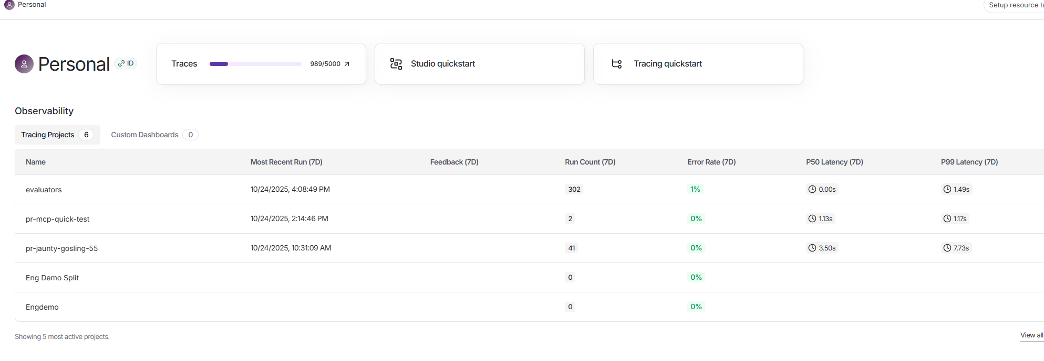
Langsmith

Slide 61
Math Chabot evaluation by LangSmith
LangSmith Evaluation Example
1. Dataset creation
2. LLM-as-judge evaluators
3. A/B testing with different system prompts
4. Trajectory evaluation with tool usage
5. Comparative experiments

Slide 62
Math Chatbot Datasets
Datasets are collections of test examples with inputs and expected outputs that enable repeatable testing.
from langsmith import Client
client = Client()
dataset_name = "Math Calculator QA"
# Create dataset
if not client.has_dataset(dataset_name=dataset_name):
dataset = client.create_dataset(
dataset_name=dataset_name,
description="Math questions requiring calculator tool usage"
)
else:
dataset = client.read_dataset(dataset_name=dataset_name)

Slide 63
Math Chatbot: How Do We Create Dataset Examples?
Our Math Calculator QA dataset includes 4 examples covering math operations and edge cases (conversational queries).
examples = [
{
"inputs": {"question": "What is 15 plus 27?"},
"outputs": {
"answer": "42",
"should_use_tool": True,
"expected_tool": "add"
}
},…
]
client.create_examples(
inputs=[ex["inputs"] for ex in examples],
outputs=[ex["outputs"] for ex in examples],
dataset_id=dataset.id,
)

Slide 64
Math Chatbot: How Do We Create Dataset Examples?
Use batch creation with create_examples() to add multiple test cases at once with inputs and outputs.
Each example includes the question, expected answer, and metadata about tool usage expectations.
Include edge cases like conversational queries that shouldn't trigger tool usage to validate agent behavior.

Slide 65
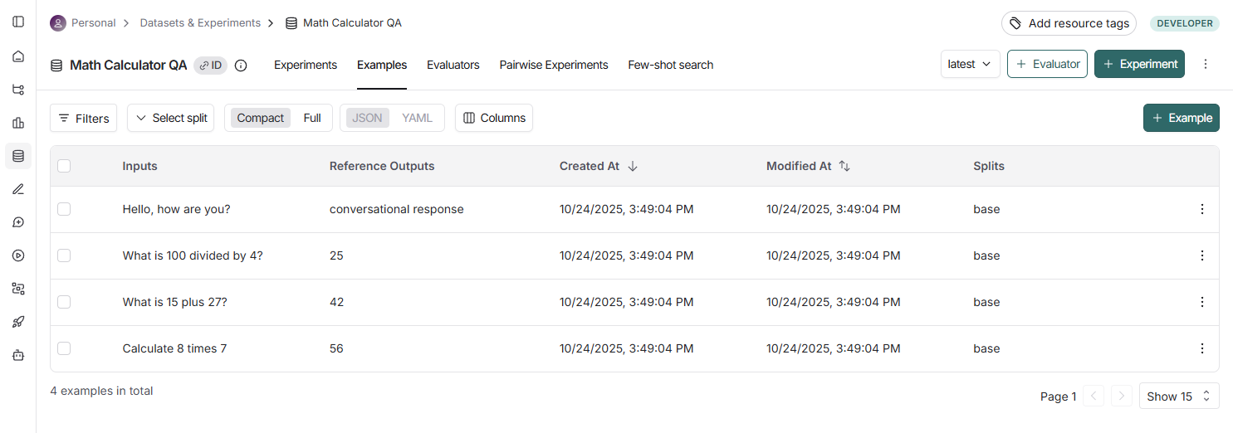
Math Chatbot Datasets
Our Math Calculator QA dataset includes 4 examples covering math operations and edge cases (conversational queries).

Slide 66
How Do We Define Tools for Agents? (LangChain Stuff)
Tools are Python functions decorated with @tool that agents can call to perform operations.
Clear docstrings are crucial - the LLM uses them to decide when to call each tool.
Our calculator has three tools: add, multiply, and divide with error handling for edge cases.

Slide 67
How Do We Define Tools for Agents? (LangChain Stuff)
from langchain_core.tools import tool
@tool
def add(a: float, b: float) -> float:
"""Add two numbers together."""
return a + b
@tool
def multiply(a: float, b: float) -> float:
"""Multiply two numbers together."""
return a * b
@tool
def divide(a: float, b: float) -> float:
"""Divide first number by second number."""
if b == 0:
return "Error: Division by zero"
return a / b
tools = [add, multiply, divide]
tools_by_name = {t.name: t for t in tools}

Slide 68
A/B testing and Agent Factory Pattern
A factory function creates agents with different configurations while maintaining the same core logic.
It enables easy A/B testing by generating variants with different system prompts or parameters.
The factory captures trajectories (execution history) and extracts tool calls for evaluation.

Slide 69
def create_agent(system_prompt: str):
"""Factory function to create agents with different system prompts."""
def agent_with_tools(inputs: dict) -> dict:
question = inputs["question"]
trajectory = []
llm_with_tools = agent_llm.bind_tools(tools)
messages = [SystemMessage(content=system_prompt), HumanMessage(content=question)]
trajectory.append({"step": "initial", "type": "user_message", "content": question})
max_iterations = 3
for iteration in range(max_iterations):
response = llm_with_tools.invoke(messages)
messages.append(response)
trajectory.append({
"step": f"llm_response_{iteration}", "type": "ai_message",
"content": response.content,
"tool_calls": len(response.tool_calls) if hasattr(response, 'tool_calls') else 0
})
if hasattr(response, 'tool_calls') and response.tool_calls:
for tool_call in response.tool_calls:
tool_result = tools_by_name[tool_call["name"]].invoke(tool_call["args"])
trajectory.append({
"step": f"tool_call_{iteration}", "type": "tool_call",
"tool": tool_call["name"], "args": tool_call["args"], "result": tool_result
})
messages.append(ToolMessage(content=str(tool_result), tool_call_id=tool_call["id"], name=tool_call["name"]))
else:
break
return {
"answer": messages[-1].content if messages else "No response",
"trajectory": trajectory,
"tool_calls": [t for t in trajectory if t["type"] == "tool_call"]
}
return agent_with_tools
# Usage
agent_a = create_agent(SYSTEM_PROMPT_A)
agent_b = create_agent(SYSTEM_PROMPT_B)

Slide 70
Rule base evaluator with Math Chatbot
Rule-based evaluators use simple logic like string matching or keyword detection for fast, deterministic scoring.
The correctness evaluator checks if the expected numerical answer appears in the agent's response.
They're ideal for clear success criteria but less flexible than LLM-as-judge approaches.

Slide 71
Rule base evaluator with Math Chatbot
def correctness_evaluator(outputs: dict, reference_outputs: dict) -> dict:
"""Check if answer contains the expected numerical result."""
answer = outputs["answer"].lower()
expected = str(reference_outputs["answer"]).lower()
# Check if expected answer is in the response
score = 1 if expected in answer else 0
return {
"key": "correctness",
"score": score,
"comment": f"Expected '{expected}' in answer"
}
# Example usage:
# Input: "What is 15 plus 27?"
# Expected: "42"
# Agent output: "The answer is 42"
# Score: 1 (correct) ✅

Slide 72
Math Chatbot Trajectory Evaluation
Trajectory evaluation examines the sequence of actions an agent takes, not just the final output.
It validates that the correct tools were called when needed and that conversational queries didn't trigger tools.
This is crucial for multi-step reasoning and ensuring agents follow expected behavior patterns.

Slide 73
Trajectory Evaluation
def tool_usage_evaluator(outputs: dict, reference_outputs: dict) -> dict:
"""Check if correct tool was used when needed."""
should_use_tool = reference_outputs.get("should_use_tool", False)
expected_tool = reference_outputs.get("expected_tool")
tool_calls = outputs.get("tool_calls", [])
tools_used = [tc["tool"] for tc in tool_calls]
if should_use_tool:
if expected_tool in tools_used:
score = 1
comment = f"Correctly used {expected_tool}"
else:
score = 0
comment = f"Should use {expected_tool}, but used {tools_used}"
else:
if len(tools_used) == 0:
score = 1
comment = "Correctly did not use tools"
else:
score = 0
comment = f"Should not use tools, but used {tools_used}"
return {
"key": "tool_usage",
"score": score,
"comment": comment
}

Slide 74
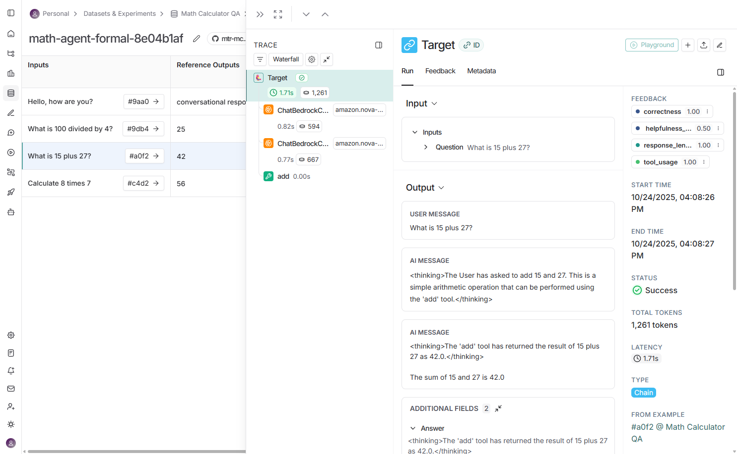
Trajectory Evaluation

Slide 75
LLM-as-Judge Evaluation
LLM-as-judge uses another LLM to assess subjective qualities like helpfulness, clarity, or tone.
It's more flexible than rule-based evaluators but slower and more expensive due to additional LLM calls.
Use low temperature (0.0) for consistency and clear scoring criteria in the judge prompt.

Slide 76
def llm_judge_helpfulness(outputs: dict, reference_outputs: dict) -> dict:
"""Use LLM to judge the helpfulness of the response."""
judge_prompt = f"""You are evaluating an AI assistant's response for helpfulness.
Question: {reference_outputs.get('question', 'N/A')}
Response: {outputs['answer']}
Rate the helpfulness on a scale of 0-1:
- 1.0: Very helpful, clear, and answers the question well
- 0.5: Somewhat helpful but could be clearer
- 0.0: Not helpful or confusing
Respond with ONLY a number between 0 and 1 (e.g., 0.8)"""
judge_response = judge_llm.invoke([HumanMessage(content=judge_prompt)])
score_text = judge_response.content.strip()
# Extract number from response
import re
match = re.search(r'0\.\d+|1\.0|0|1', score_text)
if match:
score = float(match.group())
else:
score = 0.5 # Default if can't parse
return {
"key": "helpfulness_llm_judge",
"score": score,
"comment": f"LLM judged: {score_text[:50]}"
}

Slide 77
Heuristic Evaluation
Heuristic evaluators apply simple rules like checking response length, format, or structure.
The response_length evaluator ensures answers are concise (20-200 characters) without being too brief.
They're fast, free, and useful for quick sanity checks but don't assess content quality.
def response_length_evaluator(outputs: dict) -> dict:
"""Check if response is appropriately concise."""
answer = outputs["answer"]
length = len(answer)
# Good range: 20-200 characters
if 20 <= length <= 200:
score = 1
elif length < 20:
score = 0.5 # Too short
else:
score = 0.7 # A bit long but acceptable
return {
"key": "response_length",
"score": score,
"comment": f"Length: {length} chars"
}

Slide 78
Run an Experiment for Math Chatbot
Use the evaluate() function with your agent, dataset name, evaluators, and metadata for tracking.
Each experiment processes all examples, runs all evaluators, and captures metrics, latency, and traces.
Results are automatically uploaded to LangSmith with a unique experiment name for comparison.

Slide 79
from langsmith.evaluation import evaluate
results_a = evaluate(
agent_a, # Your target function
data=dataset_name,
evaluators=[correctness_evaluator, tool_usage_evaluator,
llm_judge_helpfulness, response_length_evaluator],
experiment_prefix="math-agent-formal",
description="Agent with formal, precise system prompt",
metadata={
"model": os.getenv("BEDROCK_MODEL"),
"system_prompt": "formal",
"variant": "A",
"temperature": 0.7
},
max_concurrency=2,
)
print(f"✅ Experiment A Complete: {results_a.experiment_name}")
# What gets tracked: Input: The question, Output: Agent's response, Trajectory: Full execution trace, Evaluator Scores: All 4 evaluator results, Latency: How long it took Metadata: Model, variant, temperature, etc.

Slide 80
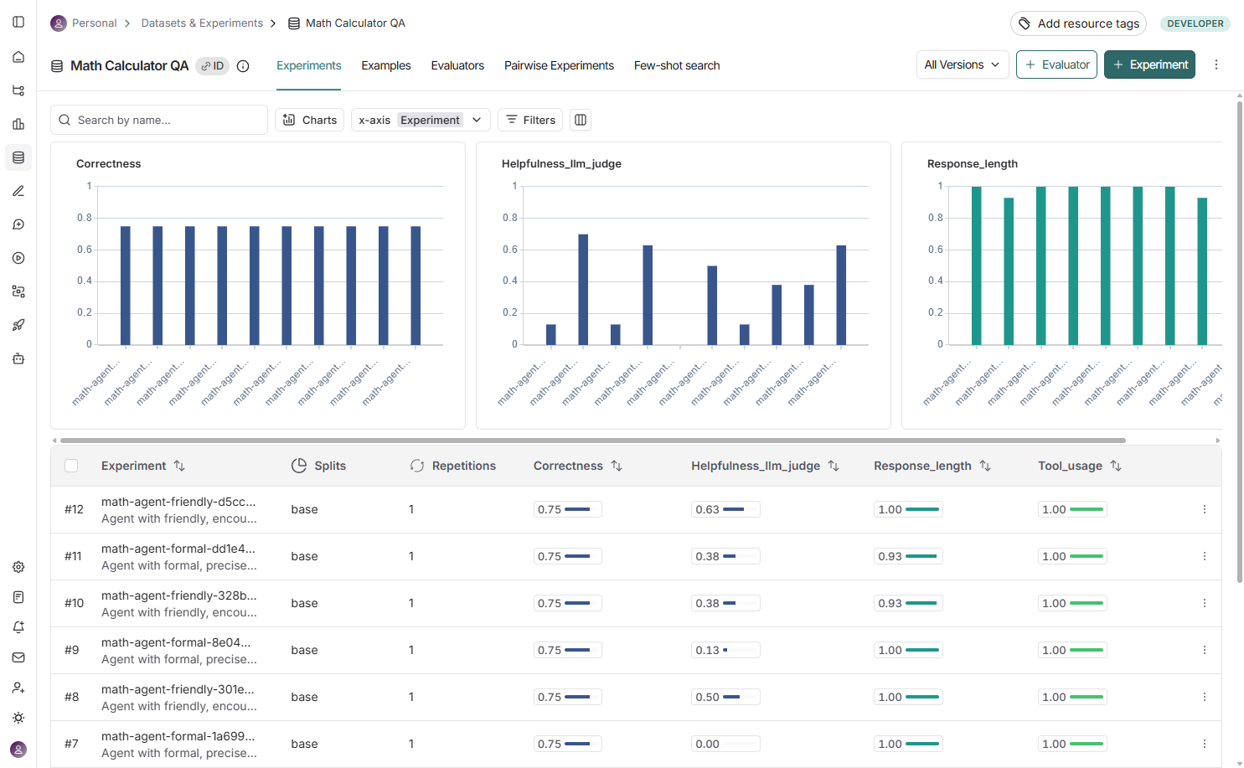

Slide 81
A/B Testing with Math Chatbot
A/B testing compares two agent variants to determine which configuration performs better.
Our example tests a formal prompt (concise, directive) vs. a friendly prompt (warm, explanatory).
Both agents use the same tools and dataset but differ in tone and instruction style.

Slide 82
A/B Testing with Math Chatbot
# Variant A: Formal system prompt
SYSTEM_PROMPT_A = """You are a precise mathematical assistant.
When asked to perform calculations, you MUST use the available calculator tools.
Always use tools for arithmetic operations. Be formal and concise."""
# Variant B: Friendly system prompt
SYSTEM_PROMPT_B = """You are a friendly and helpful math tutor!
When someone asks you to calculate something, use your calculator tools to help them out.
Use tools for math operations and explain your steps in a warm, encouraging way."""
agent_a = create_agent(SYSTEM_PROMPT_A)
agent_b = create_agent(SYSTEM_PROMPT_B)
# What's being tested?
# Tone: Formal vs. Friendly
# Length: Concise vs. Explanatory
# Instruction: "MUST use" vs. "use your tools to help"

Slide 83
How Do We Compare Two Experiments?
Run both variants on the same dataset with identical evaluators to ensure fair comparison.
Tag each experiment with metadata (variant: A/B) to easily identify and filter results.
In the LangSmith UI, select both experiments and click Compare for side-by-side analysis.

Slide 84
How Do We Compare Two Experiments?
# Run Experiment A: Formal
results_a = evaluate(
agent_a,
data=dataset_name,
evaluators=evaluators,
experiment_prefix="math-agent-formal",
metadata={"variant": "A", "system_prompt": "formal"},
)
# Run Experiment B: Friendly
results_b = evaluate(
agent_b,
data=dataset_name, # Same dataset!
evaluators=evaluators, # Same evaluators!
experiment_prefix="math-agent-friendly",
metadata={"variant": "B", "system_prompt": "friendly"},
)
# Navigate to LangSmith UI:
# 1. Go to "Math Calculator QA" → "Experiments" tab
# 2. Click checkboxes for both experiments
# 3. Click "Compare" button
# 4. View side-by-side results with differences highlighted

Slide 85
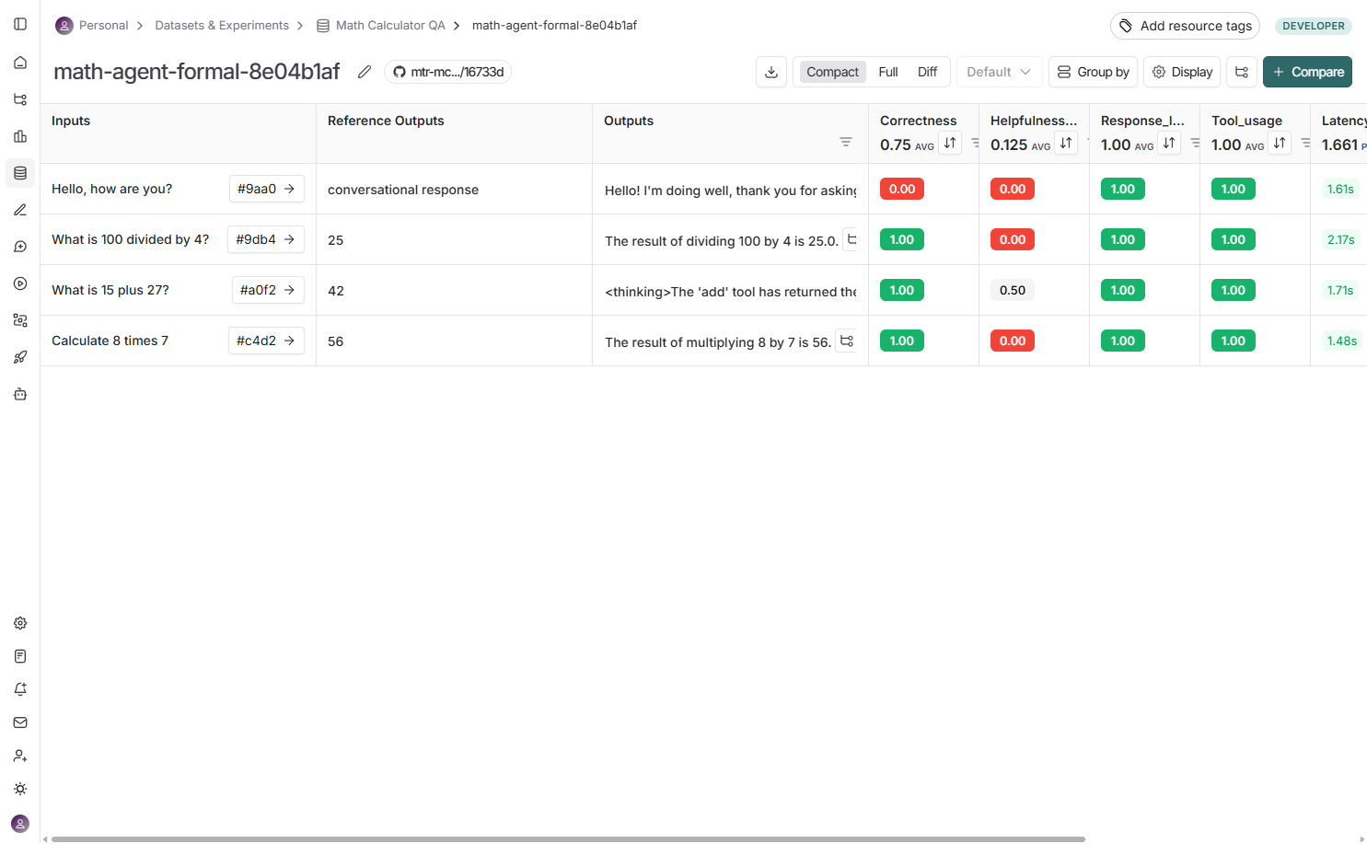

Slide 86
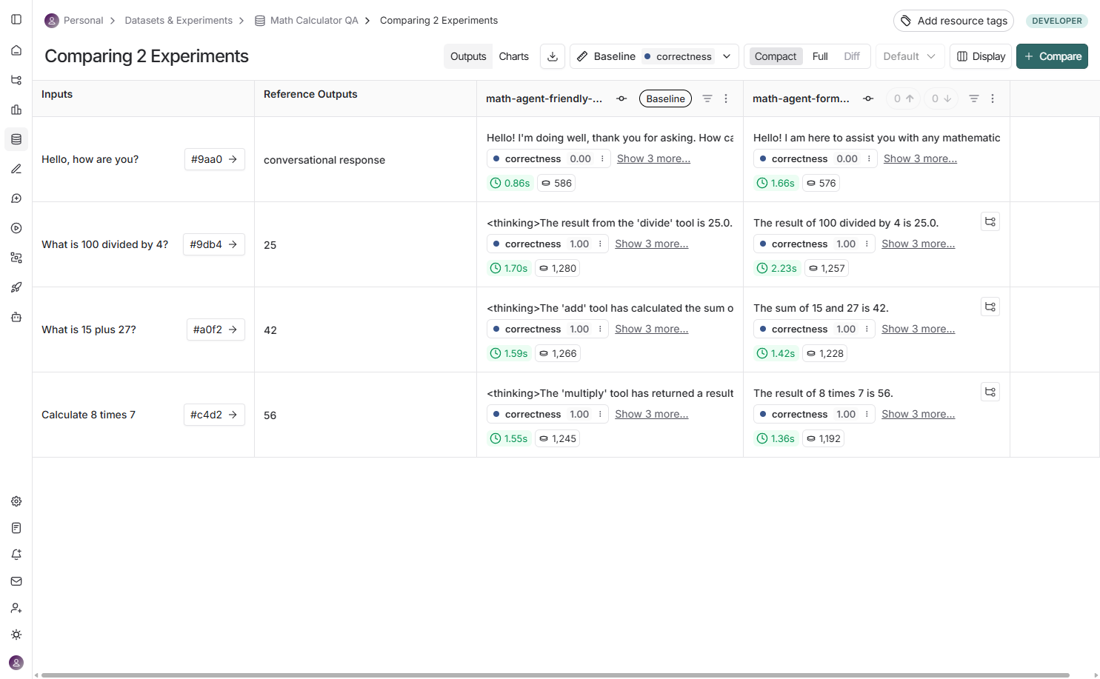

Slide 87
What Results Did We Get from A/B Testing?
Formal variant: More concise (1.00 length score), faster (fewer tokens), but lower helpfulness (0.13).
Friendly variant: Higher helpfulness (0.50), more engaging, but slightly longer responses (0.93 length score).
Both variants: Equally correct (0.75), perfect tool usage (1.00) - the trade-off is conciseness vs. engagement.

Slide 89
LangSmith UI: Experiment Results
The Experiments tab shows aggregate charts for all metrics (correctness, helpfulness, tool usage, length).
Each experiment row displays scores, latencies (P50, P99), error rates, and metadata columns.
Click any experiment to see detailed results for each test example with color-coded scores (green = good, red = bad).

Slide 91
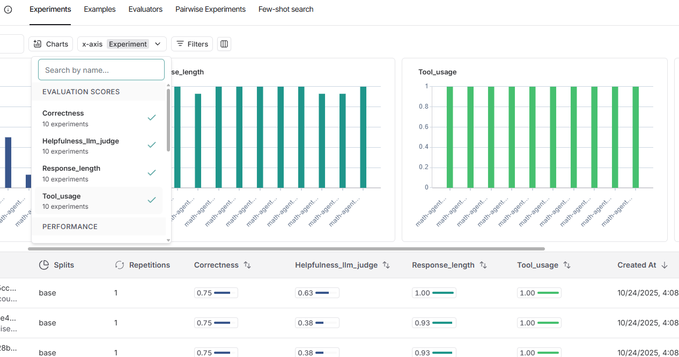

Slide 92
How Do We Capture Agent Trajectories in Math Chatbot?
Build trajectory tracking into your agent by appending each step (user message, LLM response, tool call) to an array.
Include step type, content, tool names, arguments, and results for complete execution history.
Return trajectory and extracted tool_calls in the agent output for evaluators to analyze.

Slide 93
trajectory = []
# Log user message
trajectory.append({
"step": "initial",
"type": "user_message",
"content": question
})
# In agent loop:
for iteration in range(max_iterations):
response = llm_with_tools.invoke(messages)
# Log LLM response
trajectory.append({
"step": f"llm_response_{iteration}",
"type": "ai_message",
"content": response.content,
"tool_calls": len(response.tool_calls) if hasattr(response, 'tool_calls') else 0
})
# Log tool executions
if response.tool_calls:
for tool_call in response.tool_calls:
tool_result = tools_by_name[tool_call["name"]].invoke(tool_call["args"])
trajectory.append({
"step": f"tool_call_{iteration}",
"type": "tool_call",
"tool": tool_call["name"],
"args": tool_call["args"],
"result": tool_result
})
# Return trajectory with final answer
return {
"answer": final_answer,
"trajectory": trajectory,
"tool_calls": [t for t in trajectory if t["type"] == "tool_call"]
}

Slide 94
What are Best Practices for Evaluation?
Use multiple evaluator types (rule-based + trajectory + LLM-judge) for comprehensive assessment.
Always establish a baseline before making changes and run on the same dataset for fair comparison.
Include edge cases in datasets (conversational queries, error conditions) to test boundary behavior.

Slide 95
# Best practice: Multiple evaluator types
evaluators = [
correctness_evaluator, # Rule-based (exact match)
tool_usage_evaluator, # Trajectory (action validation)
llm_judge_helpfulness, # LLM-as-judge (quality)
response_length_evaluator, # Heuristic (format check)
]
# Best practice: Baseline first
baseline = evaluate(
current_agent,
data=dataset_name,
evaluators=evaluators,
experiment_prefix="baseline",
metadata={"version": "v1.0"}
)
# Best practice: Edge cases in dataset
examples = [
{"inputs": {"question": "What is 5 + 3?"}, ...}, # Normal case
{"inputs": {"question": "Hello!"}, ...}, # No tool needed
{"inputs": {"question": "10 / 0"}, ...}, # Error case
{"inputs": {"question": "Calculate 2+3*4"}, ...}, # Order of operations
]

Slide 96
How Do We Optimize Evaluation Performance?
Use max_concurrency to process multiple examples in parallel (2-4 for safety, up to 10 for speed).
Skip expensive LLM-as-judge evaluators during rapid iteration, add them back for final validation.
Consider using smaller dev datasets (10 examples) for quick testing before running full evaluation.

Slide 97
How Do We Optimize Evaluation Performance?
# Fast evaluation with higher concurrency
results = evaluate(
agent,
data=dataset_name,
evaluators=[
correctness_evaluator, # Fast ⚡
tool_usage_evaluator, # Fast ⚡
# llm_judge_helpfulness, # Slow 🐌 - skip for iteration
response_length_evaluator, # Fast ⚡
],
max_concurrency=10, # Higher for speed
)
# Use dev/prod dataset split
dev_dataset = "Math Calculator QA - Dev" # 10 examples
prod_dataset = "Math Calculator QA" # 100 examples
# Iterate on dev
dev_results = evaluate(agent, data=dev_dataset, evaluators=fast_evaluators)
# Final validation on prod
prod_results = evaluate(agent, data=prod_dataset, evaluators=all_evaluators)

Slide 98
What is the Complete Evaluation Workflow?
Create dataset → Define evaluators → Run baseline → Make improvements → Run new experiment → Compare.
The iterative cycle of test-measure-improve leads to more reliable and capable AI systems over time.
LangSmith tracks everything: experiments, traces, metrics, and metadata for reproducibility and collaboration.

Slide 99
# Complete evaluation workflow
from langsmith import Client
from langsmith.evaluation import evaluate
# 1. Create dataset
client = Client()
dataset = client.create_dataset("Math Calculator QA")
client.create_examples(inputs=[...], outputs=[...], dataset_id=dataset.id)
# 2. Define evaluators
evaluators = [correctness, tool_usage, helpfulness, conciseness]
# 3. Run baseline
baseline = evaluate(
agent_v1,
data=dataset,
evaluators=evaluators,
experiment_prefix="baseline"
)
# 4. Make improvements to your agent
# ... modify prompts, add tools, tune parameters ...
# 5. Run new experiment
improved = evaluate(
agent_v2,
data=dataset, # Same dataset
evaluators=evaluators, # Same evaluators
experiment_prefix="improved"
)
# 6. Compare results in UI
print(f"Baseline: {baseline.experiment_name}")
print(f"Improved: {improved.experiment_name}")
# Navigate to LangSmith UI → Select both → Compare

Slide 100
What Key Insights Did We Learn?
Systematic evaluation reveals objective trade-offs: formal prompts are concise but less engaging.
Multiple evaluator types catch different issues: correctness, tool usage, helpfulness, and format.
The Math Calculator QA system demonstrates all concepts: datasets, tools, trajectories, evaluators, A/B testing.

Slide 101
Summary: Key Concepts Demonstrated
1. DATASETS
Created 'Math Calculator QA' with 4 examples
Includes inputs, expected outputs, and metadata
2. TOOL USAGE & TRAJECTORY
Defined 3 calculator tools (add, multiply, divide)
Tracked tool calls in agent trajectory
Evaluated correct tool usage
3. A/B TESTING
Variant A: Formal system prompt
Variant B: Friendly system prompt
Ran separate experiments for each variant

Slide 102
Summary: Key Concepts Demonstrated
4. MULTIPLE EVALUATORS
Correctness: String match for numerical answers
Tool Usage: Trajectory evaluation
LLM-as-Judge: Helpfulness assessment
Response Length: Conciseness check
5. EXPERIMENTS
Two independent experiments (A and B)
Metadata tracking for comparison
Full traces and metrics in LangSmith UI
6. RESULTS
Formal: More concise, faster
Friendly: More helpful, engaging
Both: Equally correct, perfect tool usage

Slide 103
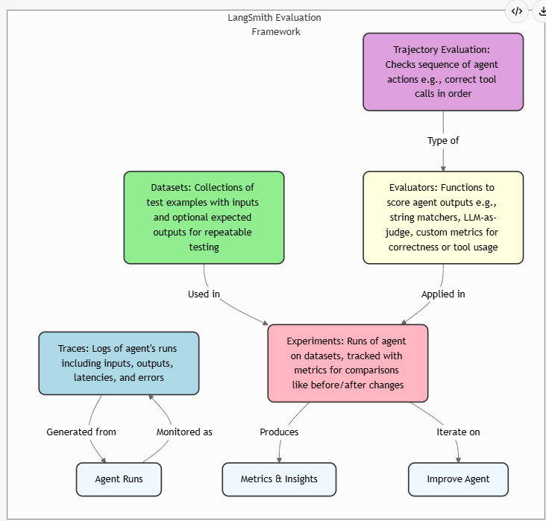
Summary: Key Concepts Demonstrated

Slide 104
Colab
https://github.com/enoch-sit/langsmithdemo/blob/main/Tutorial_LangSmith_Evaluation.ipynb

